Slide 1
OPEN CV (LANE DETECTION)
BY : Saksham SHRIVASTAVA
AKSHAY TANWAR
ANURAG MUNJAL

Slide 2
OBJECTIVE:
The main goal is to detect the lane marks so that the vehicle has a tendency to know its lane so that it can drive in its own lane. A lane detection system is an important element of many intelligent transport systems.

Slide 3
INTRO –
In this project the car will detect road lanes itself and detect various objects like cars, traffic signals, road signs and humans using XML files which we have created using HAAR cascade GUI trainer .
Sources of data ->
https://www.kaggle.com/jessicali9530/stanford-cars-dataset#cars_test.zip
http://image-net.org/api/text/imagenet.synset.geturls?wnid=n06874185

Slide 4
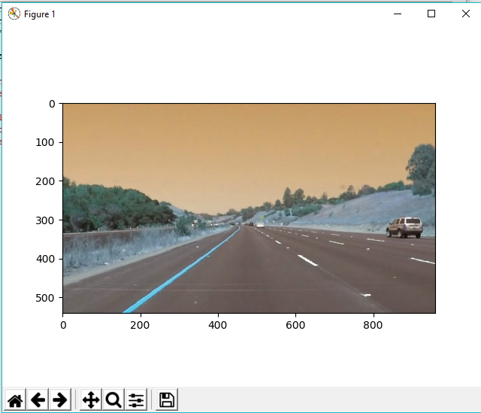
MODULES–
Modules used :
MATPLOTLIB –
We used .plot & .show function for
plotting the image in a graph so that
we can find the coordinates of the
polygon which helped us to
define our region of interest.

Slide 5
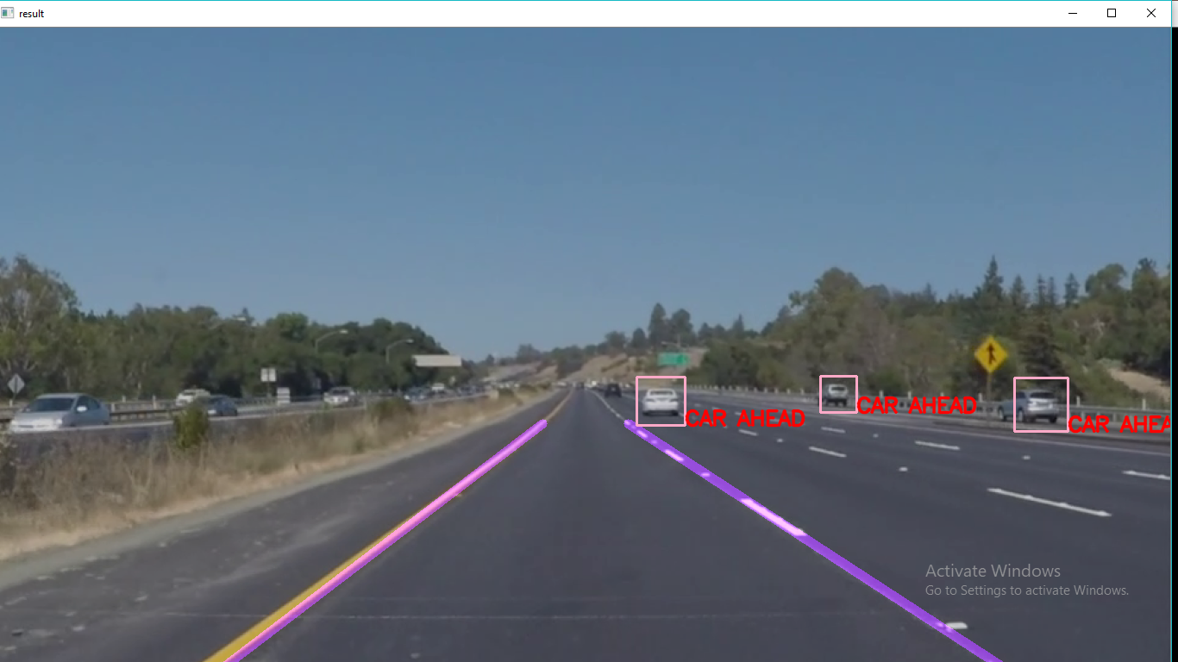
NUMPY – It is used for manipulating arrays.
OpenCV – It is used for reading and writing video and for performing various functions such as image thresh holding, canny edge detection, etc.

Slide 6
FUNCTIONAL MODULES:
def canny(image):
gray=cv2.cvtColor(image, cv2.COLOR_RGB2GRAY) =➔ here we r using cvtColor function of cv2 module whose first
parameter is image as an input and another function COLOR_RGB2GRAY which
is converting image into grayscale.
blur=cv2.GaussianBlur(gray,(5,5),0) ➔ image smoothening
canny=cv2.Canny(blur,50,150) ➔edge detection
return canny

Slide 7
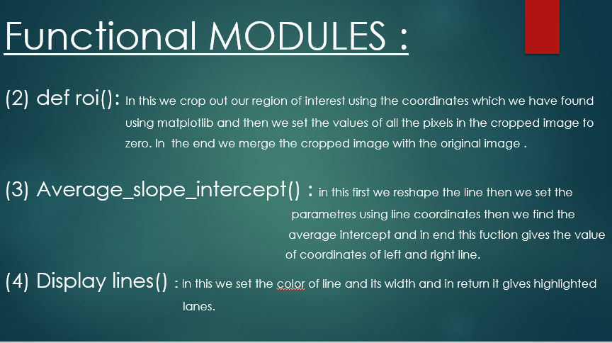

Slide 8
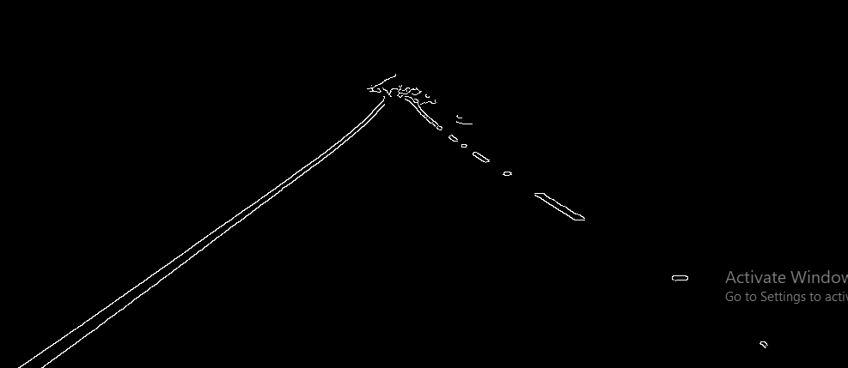
ALGO–
ALGORITHEM USED ->
HOUGH TRANSFORM ALGORITHM –
It is used in image processing to
detect line.
It can detect the line even if it
is broken or distorted a little bit.
To apply the Houghline method,
first an edge detection of the canny
image is desirable.

Slide 9
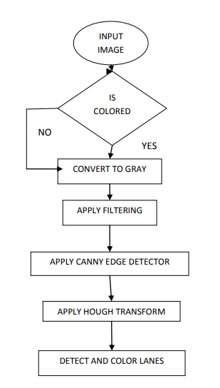
ALGO FLOWCHART :

Slide 10
SOURCE CODE OPENER-
In this project we will use OPENCV module our QR code using PYZBAR module so that we can access or view our source code.
Modules used ->
OPENCV – To access webcam so that we see the QR code.
OS – In this we will use .startfile function to access the path of code.
PYZBAR – It will read the QR code & grant access to source code.

Slide 11
Image to text Converter -
The converter will take an image as input and will print all the text in the image and convert it into a speech and in the end it will translate it in Hindi.
Modules used ->
PYTTSX3 – This module will convert our text to speech.
OPENCV – With this we will convert the image into grayscale then into canny, so that it easily read the text.

Slide 12
CONCLUSION:
Our model can only detect straight line and when a curved lane appears then it shows inaccurate results. Therefore the further improvements can be done to detect curved lanes also.

Slide 13
FUTURE WORK:
In the near future, one can modify the existing Hough Transformation so that it can measure both the curved and straight roads.

Slide 14
THANK YOU

